Slide 1

FILM DEATHS AND IMDB RATINGS: A DATASET EXPLORATION
10.30.2023
Sai Nandini Peesapati

Slide 2

Page 03
Table Of Content
Introduction
Data and Its Attributes
Exploratory Data Analysis
Conclusion / Takeaway
2

Slide 3

Introduction
How have film death counts evolved over the years/decades?
How does deaths/killings in the movies affect the movie’s rating?
Which genres can we observe the most killings?
How does the body count vary across the films?

Slide 4
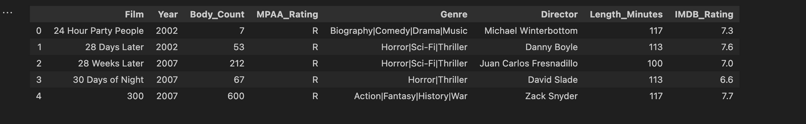
The 3 statements:
Columns???
Rows??
Dataset???

Slide 5
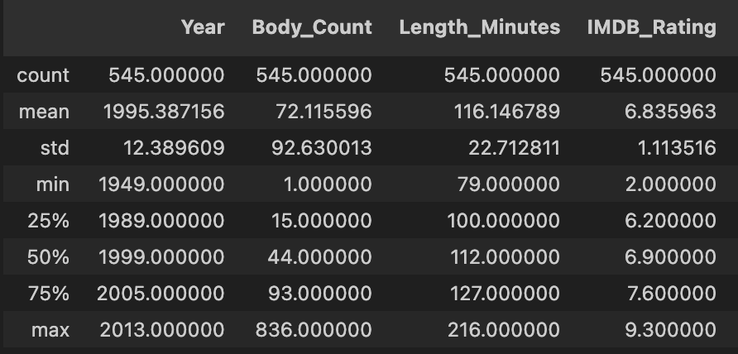
Descriptive Statistics

Slide 6
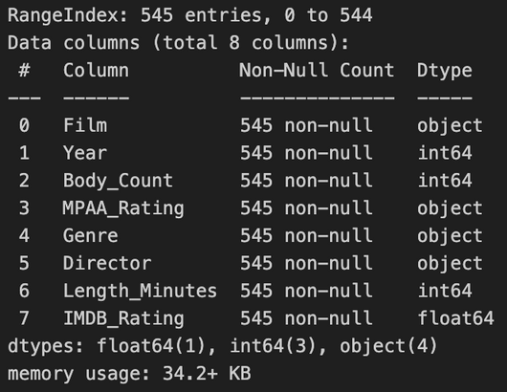
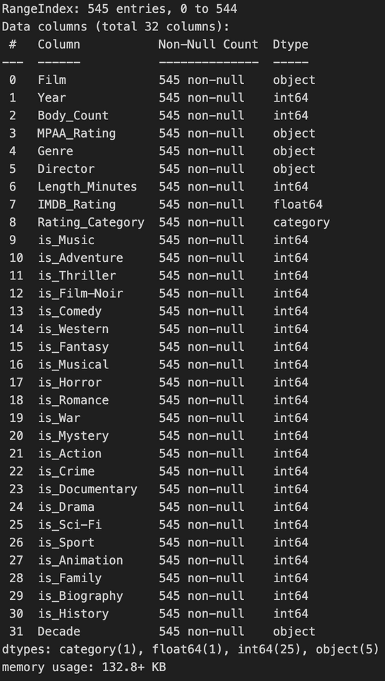

EDA - Understanding Our DataSet
What does our data look like
What was added and Why?
After manipulating the data, our new dataset contains 545 rows and 32 columns.
Our original dataset consists of 545 rows and 8 columns

Slide 7
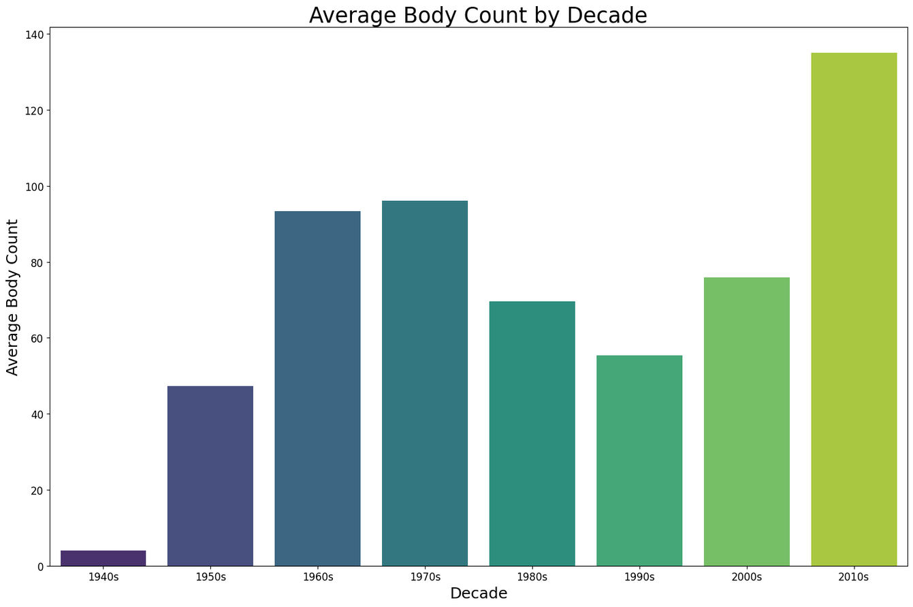
EDA - Bar Plot
Why this Graph?
To understand how the portrayal of violence or deaths in movies has evolved over different decades.
What do we understand from this?
The portrayal of violence, as indicated by the average body count, has generally increased over time, especially seeing a significant jump in the 2010s. This could reflect changes in audience preferences, film-making styles, or societal contexts over the years.

Slide 8
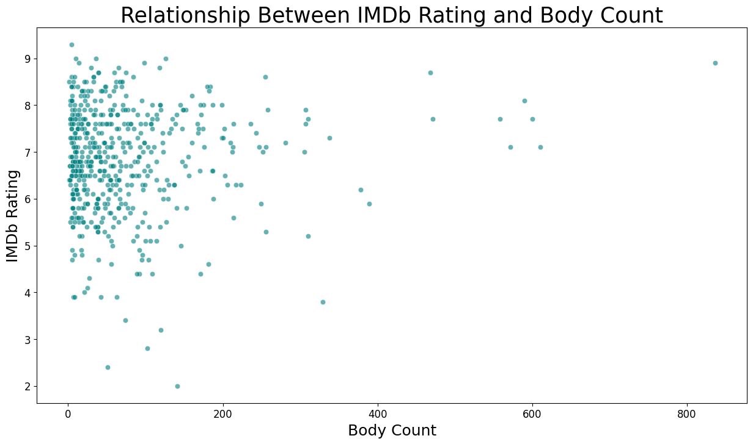
EDA - Scatter Plot
Why this Graph?
To determine if there's a correlation between the level of violence (body count) in movies and their IMDb ratings. This could reveal if audiences rate movies with more violence differently than those with less.
What do we understand from this?
We can observe that there wasn't a strong linear correlation between IMDb rating and body count. Movies with both high and low body counts were spread across different IMDb ratings, indicating that the number of deaths in a movie doesn't necessarily dictate its rating. A correlation coefficient close to 0 would suggest a weak linear relationship, while values closer to 1 or -1 would suggest strong positive or negative relationships, respectively. In the context of the dataset, even if there's no strong linear correlation, it doesn't mean there's no relationship at all; it could be non-linear or influenced by other factors.

Slide 9
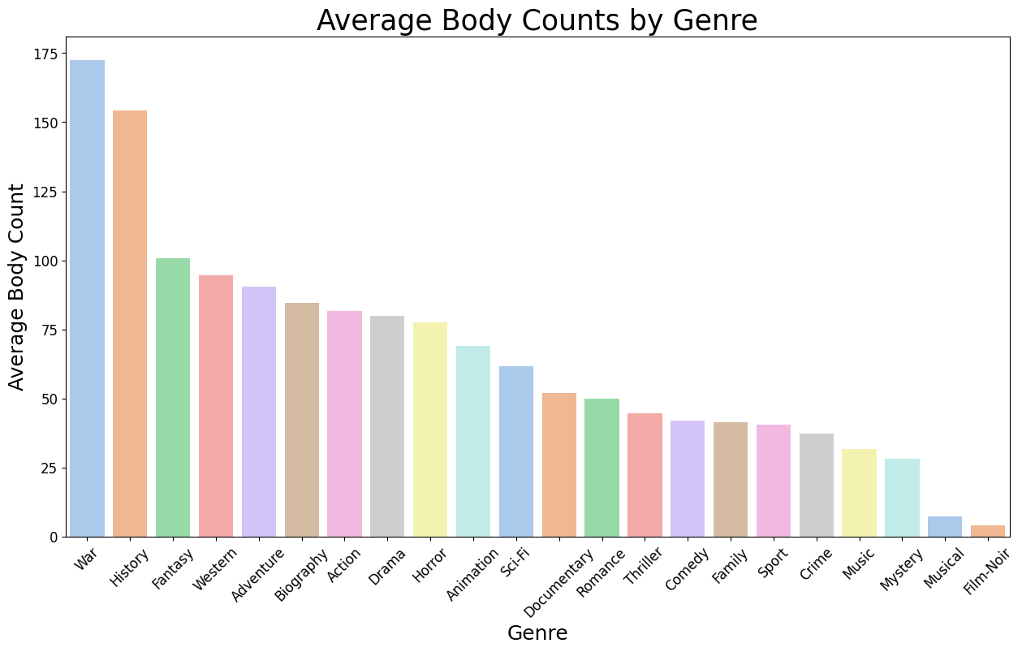
EDA - Bar Plot
Why this Graph?
To analyze the average level of violence or deaths across different film genres. This can shed light on which genres inherently involve more violent or deadly scenarios.
What do we understand from this?
Genres like War and History inherently have higher body counts, reflecting their themes around real-life events, battles, and historical conflicts. In contrast, genres like Musical or Film Noir have fewer deaths, indicating a different thematic focus. This chart helps in understanding the intrinsic nature of genres concerning their portrayal of violence or deaths.

Slide 10
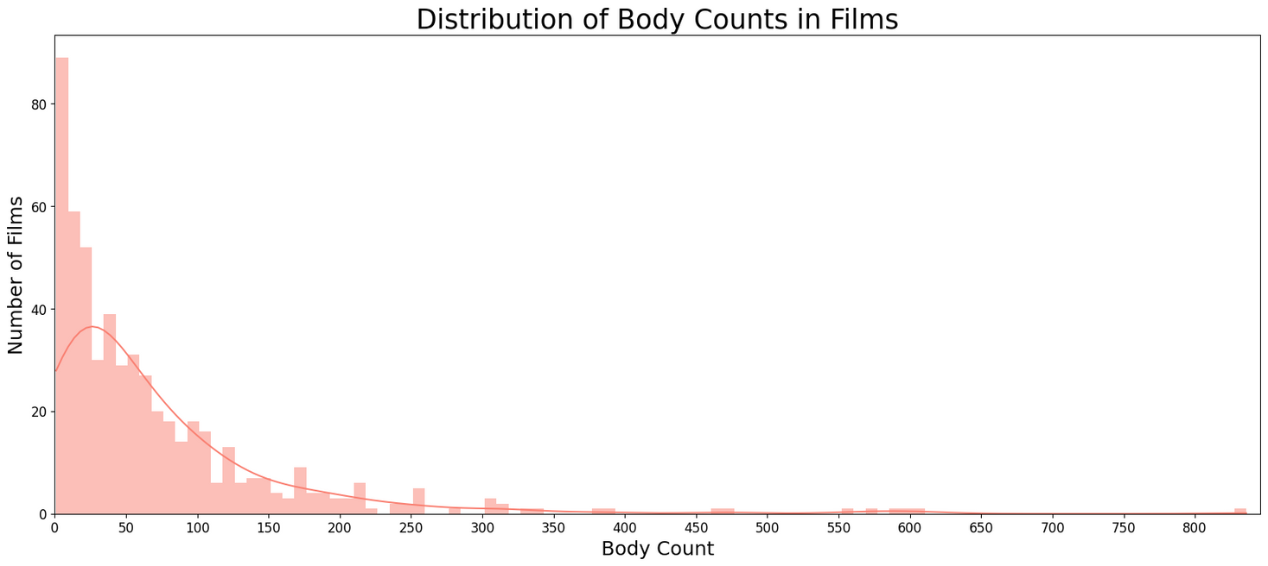
EDA - Histogram
Why this Graph?
The graph provides a visual representation of how frequently films have certain body counts.
What do we understand from this?
A large number of films have a body count between 0 and 50, with this range having the highest frequency.
As the body count increases, the number of films with such counts drastically decreases. This indicates that extremely high body counts are less common in films.
There is a long tail to the distribution, showing that while fewer films have high body counts, they still exist.
There is a noticeable decrease in the number of films with body counts beyond 50, and very few films have body counts exceeding 600.

Slide 11

What Can we Takeaway from this?
Body count, as a measure of on-screen violence, varies widely among films. While there's a positive correlation between body count and box office revenue up to a point, it doesn't hold true for films with extremely high body counts.
Genre plays a significant role in determining body count, with action and war films typically having higher numbers.
Over the years, there's a trend of increasing body counts in films.
Despite the presence of films with high body counts, a significant number of films maintain low on-screen deaths.
The majority of films are rated "R", followed by "PG-13", "Unrated", "PG", and "NC-17".
Directors like John Woo and Sylvester Stallone have films with a high average body count.

Slide 12

THANK YOU

